Slide 1
Mathematical Induction

Slide 2
§5.1-5.2: Mathematical Induction
A powerful, rigorous technique for proving that a predicate P(n) is true for all positive integers.
Essentially a “domino effect” principle.
Based on a predicate-logic inference rule:
P(1)
∀n≥1 (P(n)→P(n+1))
∴∀n≥1P(n)
“The First Principle
of Mathematical
Induction”
*
School of Computer Science, BUPT

Slide 3
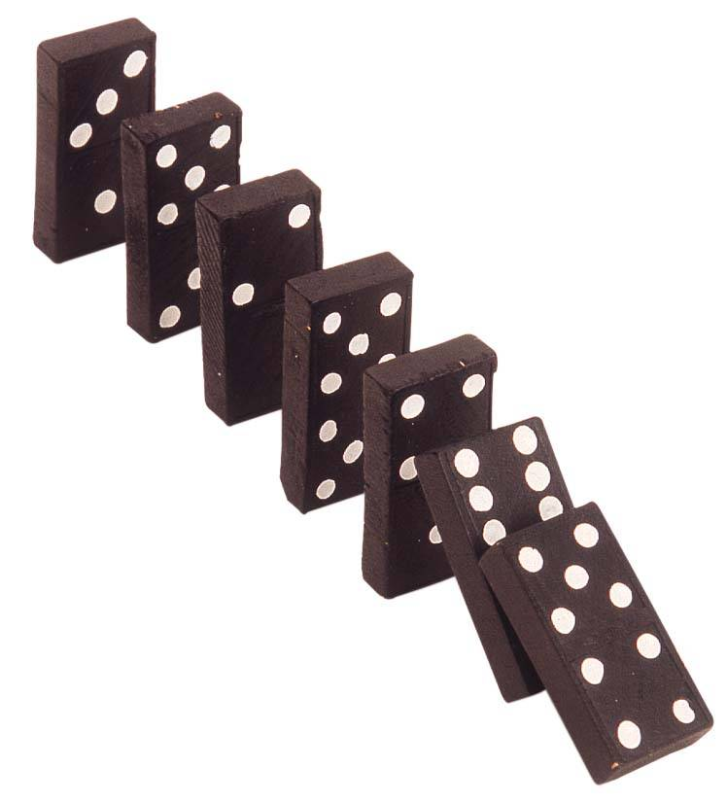
The “Domino Effect”
…
Premise #1: Domino #1 falls.
Premise #2: For every n∈N,
if domino #n falls, then so does domino #n+1.
Conclusion: All of
the dominoes fall
down!
6
5
4
Note:
this works
even if there
are infinitely
many dominoes!
3
2
1
*
School of Computer Science, BUPT

Slide 4
Validity of Induction
Proof that ∀k≥1 P(k) is a valid consequent:
Given any k≥1, the 2nd antecedent
∀n≥1 (P(n)→P(n+1)) trivially implies that
∀n≥1 (n<k)→(P(n)→P(n+1)), i.e., that (P1)→P(2)) ∧ (P(2)→P(3)) ∧ … ∧ (P(k−1)→P(k)).
Repeatedly applying the hypothetical syllogism rule to adjacent implications in this list k−1 times then gives us P(1)→P(k);
which together with P(1) (antecedent #1) and modus ponens gives us P(k).
Thus ∀k≥1 P(k). ■
*
School of Computer Science, BUPT

Slide 5
The Well-Ordering Property
Another way to prove the validity of the inductive inference rule is by using the well-ordering property, which says that:
  Every non-empty set of non-negative integers has a minimum (smallest) element.
  ∀ ∅⊂S⊆N : ∃m∈S : ∀n∈S : m≤n
This implies that {n|¬P(n)} (if non-empty) has a min. element m, but then the assumption that P(m−1)→P((m−1)+1) would be contradicted.
*
School of Computer Science, BUPT

Slide 6
Validity of Mathematical Induction
proof:
  Suppose that P(1) holds and P(k) → P(k + 1) is true for all positive integers k.
  Assume there is at least one positive integer n for which P(n) is false. Then the set S of positive integers for which P(n) is false is nonempty.
  By the well-ordering property, S has a least element, say m.
  We know that m can not be 1 since P(1) holds.
  Since m is positive and greater than 1, m − 1 must be a positive integer. Since m − 1 < m, it is not in S, so P(m − 1) must be true.
  But then, since the conditional P(k) → P(k + 1) for every positive integer k holds, P(m) must also be true. This contradicts P(m) being false.
  Hence, P(n) must be true for every positive integer n.

Slide 7
Outline of an Inductive Proof
Let us say we want to prove ∀n P(n)…
  Do the base case (or basis step): Prove P(1).
  Do the inductive step: Prove ∀n P(n)→P(n+1).
    E.g. you could use a direct proof, as follows:
    Let n∈N, assume P(n). (inductive hypothesis)
    Now, under this assumption, prove P(n+1).
  The inductive inference rule then gives us
  ∀n P(n).
*
School of Computer Science, BUPT

Slide 8
Generalizing Induction
Rule can also be used to prove ∀n≥c P(n) for a given constant c∈Z, where maybe c≠1.
  In this circumstance, the base case is to prove P(c) rather than P(1), and the inductive step is to prove ∀n≥c (P(n)→P(n+1)).
Induction can also be used to prove
∀n≥c P(a_{n}) for any arbitrary series {a_{n}}.
Can reduce these to the form already shown.
*
School of Computer Science, BUPT

Slide 9
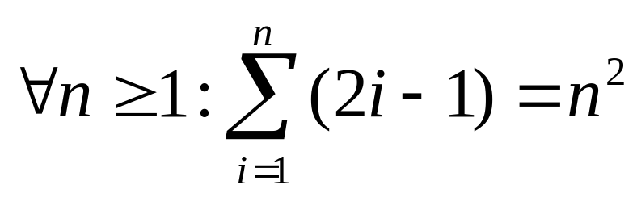
Induction Example (1st princ.)
Prove that the sum of the first n odd positive integers is n². That is, prove:
Proof by induction.
  Base case: Let n=1. The sum of the first 1 odd positive integer is 1 which equals 1².
  (Cont…)
P(n)
*
School of Computer Science, BUPT

Slide 10
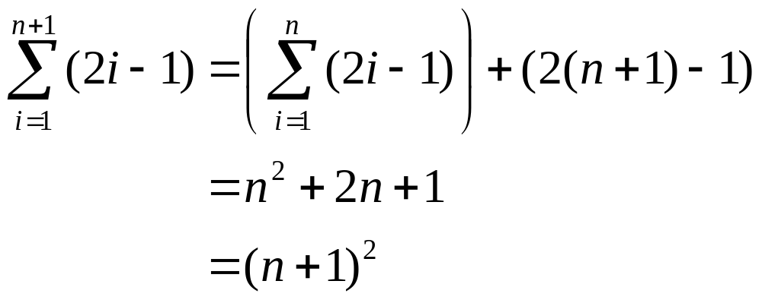
Example cont.
Inductive step: Prove ∀n≥1: P(n)→P(n+1).
  Let n≥1, assume P(n), and prove P(n+1).
By inductive
hypothesis P(n)
*
School of Computer Science, BUPT

Slide 11
Another Induction Example
Prove that ∀n>0, n<2^{n}. Let P(n)=(n<2^{n})
  Base case: P(1)=(1<2¹)=(1<2)=T.
  Inductive step: For n>0, prove P(n)→P(n+1).
    Assuming n<2^{n}, prove n+1 < 2^{n+1}.
    Note n + 1 < 2^{n} + 1 (by inductive hypothesis)
    < 2^{n} + 2^{n} (because 1<2=2⋅2⁰≤2⋅2^{n-1}= 2^{n})
    = 2^{n+1}
    So n + 1 < 2^{n+1}, and we’re done.
*
School of Computer Science, BUPT

Slide 12
Proving Inequalities
Example: Use mathematical induction to prove that 2^{n} < n!, for every integer n ≥ 4.
Solution: Let P(n) be the proposition that 2^{n} < n!.
  BASIS STEP: P(4) is true since 2⁴ = 16 < 4! = 24.
  INDUCTIVE STEP: Assume P(k) holds, i.e., 2^{k} < k! for an arbitrary integer k ≥ 4. To show that P(k + 1) holds:
  2^{k+1} = 2∙2^{k}
  < 2∙ k! (by the inductive hypothesis)
  < (k + 1)k!
  = (k + 1)!
  Therefore, 2^{n} < n! holds, for every integer n ≥ 4.
Note that here the basis step is P(4), since P(0), P(1), P(2), and P(3) are all false.

Slide 13
Second Principle of Induction
A.k.a. “Strong Induction”
Characterized by another inference rule:
P(1)
∀n≥1: (∀1≤k≤n P(k)) → P(n+1)
∴∀n≥1: P(n)
The only difference between this and the 1st principle is that:
  the inductive step here makes use of the stronger hypothesis that P(k) is true for all smaller numbers k<n+1, not just for k=n.
P is true in all previous cases
*
School of Computer Science, BUPT

Slide 14
Another 2nd Principle Example
Prove that every amount of postage of 12 cents or more can be formed using just 4-cent and 5-cent stamps. P(n)=“n can be…”
Base case: 12=3(4), 13=2(4)+1(5), 14=1(4)+2(5), 15=3(5), so ∀12≤n≤15, P(n).
Inductive step: Let n≥15, assume
∀12≤k≤n P(k). Note 12≤n−3≤n, so P(n−3), so add a 4-cent stamp to get postage for n+1.
*
School of Computer Science, BUPT

Slide 15
strong induction
BASIS STEP: We can form postage of 12, 13, 14, and 15 cents using three 4-cent stamps, two 4-cent stamps and one 5-cent stamp, one 4-cent stamp and two 5-cent stamps, and three 5-cent stamps, respectively. This shows that P(12), P(13), P(14), and P(15) are true.
INDUCTIVE STEP:
  The inductive hypothesis is the statement that P(j) is true for 12 ≤ j ≤ k, where k is an integer with k ≥ 15.
  To complete the inductive step, we assume that we can form postage of j cents, where 12 ≤ j ≤ k. We need to show that under the assumption that P(k + 1) is true, we can also form postage of k + 1 cents.
  Using the inductive hypothesis, we can assume that P(k − 3) is true because k − 3 ≥ 12, that is, we can form postage of k − 3 cents using just 4-cent and 5-cent stamps. To form postage of k + 1 cents, we need only add another 4-cent stamp to the stamps we used to form postage of k − 3 cents.
  That is, we have shown that if the inductive hypothesis is true, then P(k + 1) is also true. This completes the inductive step.
*
School of Computer Science, BUPT

Slide 16
Proof of Same Example using Mathematical Induction
Example: Prove that every amount of postage of 12 cents or more can be formed using just 4-cent and 5-cent stamps.
Solution: Let P(n) be the proposition that postage of n cents can be formed using 4-cent and 5-cent stamps.
  BASIS STEP: Postage of 12 cents can be formed using three 4-cent stamps.
  INDUCTIVE STEP: The inductive hypothesis P(k) for any positive integer k is that postage of k cents can be formed using 4-cent and 5-cent stamps. To show P(k + 1) where k ≥ 12 , we consider two cases:
    If at least one 4-cent stamp has been used, then a 4-cent stamp can be replaced with a 5-cent stamp to yield a total of k + 1 cents.
    Otherwise, no 4-cent stamp have been used and at least three 5-cent stamps were used. Three 5-cent stamps can be replaced by four 4-cent stamps to yield a total of k + 1 cents.
Hence, P(n) holds for all n ≥ 12.

Slide 17
The Method of Infinite Descent
A way to prove that P(n) is false for all n∈N.
Sort of a converse to the principle of induction.
Prove first that ∀P(n): ∃k<n: P(k).
  Basically, “For every P there is a smaller P.”
But by the well-ordering property of N, we know
that ∃P(m) → ∃P(n): ∀P(k): n≤k.
  Basically, “If there is a P, there is a smallest P.”
Note that these are contradictory unless ¬∃P(m),
  that is, ∀m∈N: ¬P(m). There is no P.
思路：
假设一个最小值，又找到比它还小的
*
School of Computer Science, BUPT

Slide 18
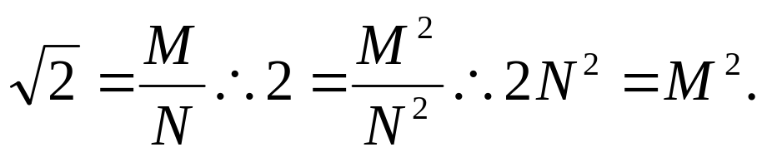
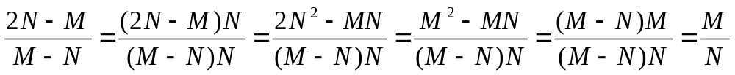
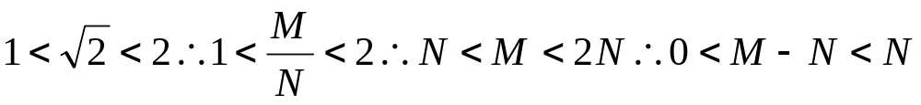
Infinite Descent Example
Theorem: 2^{1/2} is irrational.
Proof: Suppose 2^{1/2} is rational, then ∃m,n∈Z⁺: 2^{1/2}=m/n. Let M,N be the m,n with the least n.
So ∃k<N,j: 2^{1/2} = j/k (let j=2N−M, k=M−N). ■
*
School of Computer Science, BUPT

Slide 19
Which Form of Induction Should Be Used?
We can always use strong induction instead of mathematical induction. But there is no reason to use it if it is simpler to use mathematical induction.
In fact, the principles of mathematical induction, strong induction, and the well-ordering property are all equivalent. (Exercises 41-43)
Sometimes it is clear how to proceed using one of the three methods, but not the other two.

Slide 20
Proving divisibility results
Example 8
  Use mathematical induction to prove that n³ -n is divisible by 3 whenever n is a positive integer.
Solution: Let P(n) be the proposition that n³ − n is divisible by 3.
  BASIS STEP: P(1) is true since 1³ − 1 = 0, which is divisible by 3.
  INDUCTIVE STEP: Assume P(k) holds, i.e., k³ − k is divisible by 3, for an arbitrary positive integer k. To show that P(k + 1) follows:
  (k + 1)³ − (k + 1) = (k³ + 3k² + 3k + 1) − (k + 1)
  = (k³ − k) + 3(k² + k)
  By the inductive hypothesis, the first term (k³ − k) is divisible by 3 and the second term is divisible by 3 since it is an integer multiplied by 3. So by part (i) of Theorem 1 in Section 4.1 , (k + 1)³ − (k + 1) is divisible by 3.
  Therefore, n³ − n is divisible by 3, for every integer positive integer n.
*
School of Computer Science, BUPT

Slide 21
Number of Subsets of a Finite Set
Example10 : Use mathematical induction to show that if S is a finite set with n elements, where n is a nonnegative integer, then S has 2^{n} subsets.
(Chapter 6 uses combinatorial methods to prove this result.)
Solution: Let P(n) be the proposition that a set with n elements has 2^{n} subsets.
  Basis Step: P(0) is true, because the empty set has only itself as a subset and 2⁰ = 1.
  Inductive Step: Assume P(k) is true for an arbitrary nonnegative integer k.
continued →

Slide 22
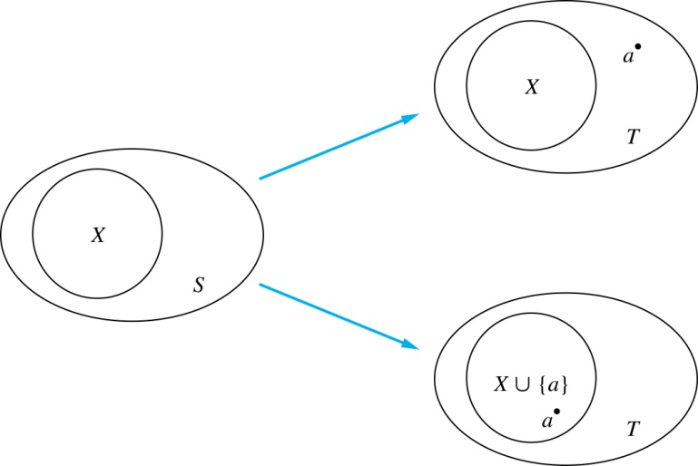
Number of Subsets of a Finite Set
Inductive Hypothesis: For an arbitrary nonnegative integer k, every set with k elements has 2^{k} subsets.
    Let T be a set with k + 1 elements. Then T = S ∪ {a}, where a ∈ T and S = T − {a}. Hence |T| = k+1.
    For each subset X of S, there are exactly two subsets of T, i.e., X and X ∪ {a}.
    By the inductive hypothesis S has 2^{k} subsets. Since there are two subsets of T for each subset of S, the number of subsets of T is 2 ∙2^{k} = 2^{k+1} .

Slide 23
Creative uses of mathematical induction
Example 13 Odd pie fights
An odd number of people stand in a yard at mutually distinct distances. At the same time each person throws a pie at their nearest neighbor, hitting this person. Use mathematical induction to show that there is at least one survivor, that is, at least one person who is not hit by a pie.
*
School of Computer Science, BUPT

Slide 24
prove
Let P(n) be the statement that there is a survivor whenever 2n + 1 people stand in a yard at distinct mutual distances and each person throws a pie at their nearest neighbor.
BASIS STEP: When n = 1, there are 2n + 1 = 3 people in the pie fight.
INDUCTIVE STEP: assume that P(k) is true for an arbitrary odd integer k with k ≥ 3. Let A and B be the closest pair of people in this group of 2k + 3 people.
  when someone else throws a pie at either A or B
  when no one else throws a pie at either A or B.
*
School of Computer Science, BUPT

Slide 25
Completion of the proof of the Fundamental Theorem of Arithmetic
Example: Show that if n is an integer greater than 1, then n can be written as the product of primes.
Solution: Let P(n) be the proposition that n can be written as a product of primes.
  BASIS STEP: P(2) is true since 2 itself is prime.
  INDUCTIVE STEP: The inductive hypothesis is P(j) is true for all integers j with 2 ≤ j ≤ k. To show that P(k + 1) must be true under this assumption, two cases need to be considered:
    If k + 1 is prime, then P(k + 1) is true.
    Otherwise, k + 1 is composite and can be written as the product of two positive integers a and b with 2 ≤ a ≤ b < k + 1. By the inductive hypothesis a and b can be written as the product of primes and therefore k + 1 can also be written as the product of those primes.
Hence, it has been shown that every integer greater than 1 can be written as the product of primes.
(uniqueness proved in Section 4.3)

Slide 26
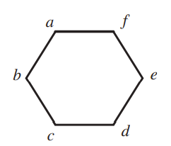
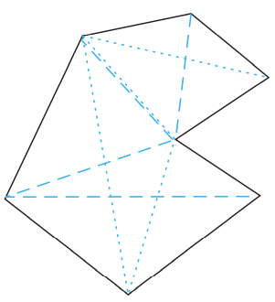
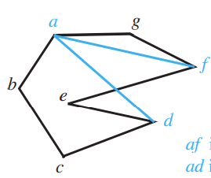
Using strong induction in computational geometry
  Polygon
  Vertex
  Simple
  Interior
  Exterior
  Diagonal
  Convex（凸的）
  Triangulation（三角形化）
Computational geometry is widely used in computer graphics, computer games, robotics, scientific calculations ……
*
School of Computer Science, BUPT
*

Slide 27
Theorem 1: Computational geometry
  A simple polygon with n sides, where n is an integer with n≥3, can be triangulated into n-2 triangles.
  Lemma: Every simple polygon with at least four sides has an interior diagonal. (which is difficult to prove.)
Proof:
  Let T(n) is the statement.
  Basis Step: T(3) is true.
  Inductive Step: Assume all T(j) is true when 3≤ j≤ k, that is a simple polygon with j sides can be triangulated into j-2 triangles. To show T(k+1) is also true, a simple polygon P with k+1 sides can be triangulated into k-1 triangles.
*
School of Computer Science, BUPT
*

Slide 28
Proof (cont):
  An interior diagonal ab splits P (with k+1 sides) into two simple polygons with s and t sides respectively (according to lemma).
  Sides: s+t-2=k+1
  We now use the inductive hypothesis. Because both 3 ≤ s ≤ k and 3 ≤ t ≤ k, by the inductive hypothesis we can triangulate the two polygons into s−2 and t−2 triangles, respectively. Thus the total triangles are s+t-4.
  Triangles: s+t-4= s+t-2-2= k+1-2=k-1
  Hence, for all n≥3 T(n) is true.
b
s
t
*
School of Computer Science, BUPT
*
a

Slide 29
Proofs Using the Well-Ordering Property
Example 6 P385
In a round-robin tournament every player plays every other player exactly once and each match has a winner and a loser. We say that the players p₁, p₂, . . . , p_{m} form a cycle if p₁ beats p₂, p₂ beats p₃, . . . , p_{m−1} beats p_{m}, and p_{m} beats p₁.
Use the well-ordering principle to show that if there is a cycle of length m (m ≥ 3) among the players in a round-robin tournament, there must be a cycle of three of these players.
*
School of Computer Science, BUPT

Slide 30
Solution: We assume that there is no cycle of three players.
Because there is at least one cycle in the round-robin tournament, the set of all positive integers n for which there is a cycle of length n is nonempty. By the well-ordering property, this set of positive integers has a least element k, which by assumption must be greater than three. Consequently, there exists a cycle of players p1, p2, p3, . . . , pk and no shorter cycle exists.
Because there is no cycle of three players, we know that k > 3. Consider the first three elements of this cycle, p1, p2, and p3.
There are two possible outcomes of the match between p1 and p3.
If p3 beats p1, it follows that p1, p2, p3 is a cycle of length three, contradicting our assumption that there is no cycle of three players. Consequently, it must be the case that p1 beats p3.
This means that we can omit p2 from the cycle p1, p2, p3, . . . , pk to obtain the cycle p1, p3, p4, . . . , pk of length k - 1, contradicting the assumption that the smallest cycle has length k.
We conclude that there must be a cycle of length three.
*
School of Computer Science, BUPT

Slide 31
Homework
§5.1
  32, 44, 54
§5.2
  4, 26
*
School of Computer Science, BUPT

Slide 32
Recursive Definitions and Structural Induction

Slide 33
Recursive Definitions
In induction, we prove all members of an infinite set satisfy some predicate P by:
  proving the truth of the predicate for larger members in terms of that of smaller members.
In recursive definitions, we similarly define a function, a predicate, a set, or a more complex structure over an infinite domain (universe of discourse) by:
  defining the function, predicate value, set membership, or structure of larger elements in terms of those of smaller ones.
In structural induction, we inductively prove properties of recursively-defined objects in a way that parallels the objects’ own recursive definitions.
*
School of Computer Science, BUPT

Slide 34
Recursion
Recursion is the general term for the practice of defining an object in terms of itself
  or of part of itself
  This may seem circular, but it isn’t necessarily.
An inductive proof establishes the truth of P(n+1) recursively in terms of P(n).
There are also recursive algorithms, definitions, functions, sequences, sets, and other structures.
*
School of Computer Science, BUPT

Slide 35
Recursively Defined Functions
Simplest case: One way to define a function f:N→S (for any set S) or series a_{n}=f(n) is to:
  Define f(0).
  For n>0, define f(n) in terms of f(0),…,f(n−1).
E.g.: Define the series a_{n} :≡ 2^{n} recursively:
  Let a₀ :≡ 1.
  For n>0, let a_{n} :≡ 2a_{n-1}.
*
School of Computer Science, BUPT

Slide 36
Another Example
Suppose we define f(n) for all n∈N recursively by:
  Let f(0)=3
  For all n∈N, let f(n+1)=2f(n)+3
What are the values of the following?
  f(1)= f(2)= f(3)= f(4)=
9
21
45
93
*
School of Computer Science, BUPT

Slide 37
Recursive definition of Factorial
Give an inductive (recursive) definition of the factorial function,
F(n) :≡ n! :≡ ∏_{1≤i≤n} i = 1⋅2⋅…⋅n.
  Base case: F(0) :≡ 1
  Recursive part: F(n) :≡ n ⋅ F(n−1).
    F(1)=1
    F(2)=2
    F(3)=6
*
School of Computer Science, BUPT

Slide 38
More Easy Examples
Write down recursive definitions for:
  i+n (i integer, n natural) using only s(i) = i+1.
  a·n (a real, n natural) using only addition
  a^{n} (a real, n natural) using only multiplication
  ∑_{0≤i≤n} a_{i} (for an arbitrary series of numbers {a_{i}})
  ∏_{0≤i≤n} a_{i} (for an arbitrary series of numbers {a_{i}})
  ∩_{0≤i≤n} S_{i} (for an arbitrary series of sets {S_{i}})
*
School of Computer Science, BUPT

Slide 39
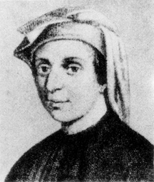
The Fibonacci Series
The Fibonacci series f_{n≥0} is a famous series defined by:
f₀ :≡ 0, f₁ :≡ 1, f_{n≥2} :≡ f_{n−1} + f_{n−2}
0
1
1
2
3
5
8
13
Leonardo Fibonacci
1170-1250
*
School of Computer Science, BUPT

Slide 40
Inductive Proof about Fib. series
Theorem: f_{n} < 2^{n}.
Proof: By induction.
Base cases: f₀ = 0 < 2⁰ = 1
f₁ = 1 < 2¹ = 2
Inductive step: Use 2nd principle of induction
(strong induction). Assume ∀k<n, f_{k} < 2^{k}.
Then f_{n} = f_{n−1} + f_{n−2} is
< 2^{n−1} + 2^{n−2} < 2^{n−1} + 2^{n−1} = 2^{n}. ■
Implicitly for all n∈N
Note use of
base cases of
recursive def’n.
*
School of Computer Science, BUPT

Slide 41
A lower bound on Fibonacci series
Theorem. For all integers n ≥ 3, f_{n} > α^{n−2}, where α = (1+5^{1/2})/2 ≈ 1.61803.
Proof. (Using strong induction.)
  Let P(n) = (f_{n} > α^{n−2}).
  Base cases: For n=3, note that α < 2 = f₃. For n=4, α² = (1+2·5^{1/2}+5)/4 = (3+5^{1/2})/2 ≈ 2.61803 < 3 = f₄.
  Inductive step: For k≥4, assume P(j) for 3≤j≤k, prove P(k+1). Note α² = α+1. Thus, α^{k−1} = (α+1)α^{k−3} = α^{k−2} + α^{k−3}. By inductive hypothesis, f_{k−1} > α^{k−3} and f_{k} > α^{k−2}. So, f_{k+1} = f_{k} + f_{k−1} > α^{k−2} + α^{k−3} = α^{k−1}. Thus P(k+1). ■
*
School of Computer Science, BUPT

Slide 42
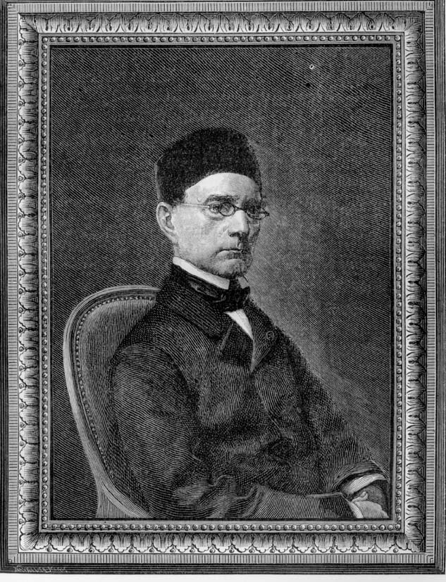
Lamé’s Theorem (拉梅定理)
Theorem: ∀a,b∈N, a≥b>0,
the number of steps in Euclid’s
algorithm to find gcd(a,b) is
≤ 5k, where k = ⎣log₁₀ b⎦+1 is the
number of decimal digits in b.
  Thus, Euclid’s algorithm is linear-
  time in the number of digits in b.
Proof:
  Uses the Fibonacci sequence!
  See next 2 slides.
Gabriel Lamé
1795-1870
*
School of Computer Science, BUPT

Slide 43
Proof of Lamé’s Theorem
Consider the sequence of division-algorithm equations used in Euclid’s alg.:
  r₀ = r₁q₁ + r₂ with 0 ≤ r₂ < r₁
  r₁ = r₂q₂ + r₃ with 0 ≤ r₃ < r₂
  …
  r_{n−2} = r_{n−1}q_{n−1} + r_{n} with 0 ≤ r_{n} < r_{n−1}
  r_{n−1} = r_{n}q_{n} + r_{n+1} with r_{n+1} = 0 (terminate)
The number of divisions (iterations) is n.
Where a = r₀,
b = r₁, and gcd(a,b)=r_{n}.
*
School of Computer Science, BUPT

Slide 44
Lamé Proof, continued
Since r₀ ≥ r₁ > r₂ > … > r_{n}, each quotient q_{i} ≡ ⎣r_{i−1}/r_{i}⎦ ≥ 1.
Since r_{n−1} = r_{n}q_{n} and r_{n−1} > r_{n}, q_{n} ≥ 2.
So we have the following relations between r and f:
  r_{n} ≥ 1 = f₂
  r_{n−1} ≥ 2r_{n} ≥ 2f₂ = f₃
  r_{n−2} ≥ r_{n−1} + r_{n} ≥ f₂ + f₃ = f₄
  …
  r₂ ≥ r₃ + r₄ ≥ f_{n−1} + f_{n−2} = f_{n}
  b = r₁ ≥ r₂ + r₃ ≥ f_{n} + f_{n−1} = f_{n+1}.
Thus, if n>2 divisions are used, then b ≥ f_{n+1} > α^{n−1}.
  Thus, log₁₀ b > log₁₀(α^{n−1}) = (n−1)log₁₀ α ≈ (n−1)0.208 > (n−1)/5.
  If b has k decimal digits, then log₁₀ b < k, so n−1 < 5k, so n ≤ 5k.
*
School of Computer Science, BUPT

Slide 45
Recursively Defined Sets
An infinite set S may be defined recursively, by giving:
  A small finite set of base elements of S.
  A rule for constructing new elements of S from previously-established elements.
  Implicitly, S has no other elements but these.
Example: Let 3∈S, and let x+y∈S if x,y∈S.
What is S?
*
School of Computer Science, BUPT

Slide 46
Structural Induction
Proving something about a recursively defined object using an inductive proof whose structure mirrors the object’s definition.
Example problem: Let 3∈S, and let x+y∈S if x,y∈S. Show that S = {n∈Z⁺| (3|n)} (the set of positive multiples of 3).
*
School of Computer Science, BUPT

Slide 47
Example continued
Let 3∈S, and let x+y∈S if x,y∈S. Let A = {n∈Z⁺| (3|n)}.
Theorem: A=S. Proof: We show that A⊆S and S⊆A.
  To show A⊆S, show [n∈Z⁺ ∧ (3|n)]→ n∈S.
    Inductive proof. Let P(n) :≡ n∈S. Induction over positive multiples of 3. Base case: n=3, thus 3∈S by def’n. of S. Inductive step: Given P(n), prove P(n+3). By inductive hyp., n∈S, and 3∈S, so by def’n of S, n+3∈S.
  To show S⊆A: let n∈S, show n∈A.
    Structural inductive proof. Let P(n):≡n∈A. Two cases: n=3 (base case), which is in A, or n=x+y (recursive step). We know x and y are positive, since neither rule generates negative numbers. So, x<n and y<n, and so we know x and y are in A, by strong inductive hypothesis. Since 3|x and 3|y, we have 3|(x+y), thus x+y ∈ A.
*
School of Computer Science, BUPT

Slide 48
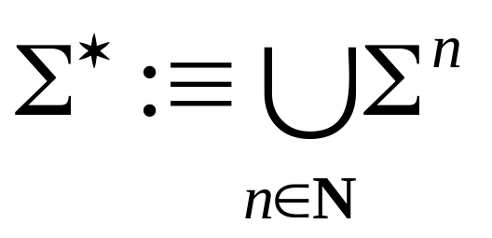
The Set of All Strings
Given an alphabet Σ, the set Σ* of all strings over Σ can be recursively defined by:
ε ∈ Σ* (ε :≡ “”, the empty string)
w ∈ Σ* ∧ x ∈ Σ → wx ∈ Σ*
Exercise: Prove that this definition is equivalent to our old one:
Book
uses λ
*
School of Computer Science, BUPT

Slide 49
Other Easy String Examples
Give recursive definitions for:
  The concatenation of strings w₁·w₂.
  The length (w) of a string w.
  Well-formed formulae of propositional logic involving T, F, propositional variables, and operators in {¬, ∧, ∨, →, ↔}.
  Well-formed arithmetic formulae involving variables, numerals, and ops in {+, −, *, ↑}.
*
School of Computer Science, BUPT

Slide 50
Rooted Trees
Trees will be covered in more depth in chapter 11.
  Briefly, a tree is a graph in which there is exactly one undirected path between each pair of nodes.
  An undirected graph can be represented as a set of unordered pairs (called arcs) of objects called nodes.
Definition of the set of rooted trees:
  Any single node r is a rooted tree.
  If T₁, …, T_{n} are disjoint rooted trees with respective roots r₁, …, r_{n}, and r is a node not in any of the T_{i}’s, then another rooted tree is {{r,r₁},…,{r,r_{n}}}∪T₁∪…∪T_{n}.
*
School of Computer Science, BUPT

Slide 51
Illustrating Rooted Tree Def’n.
How rooted trees can be combined to form a new rooted tree…
r
…
r₁
r₂
r_{n}
Draw some examples…
*
School of Computer Science, BUPT

Slide 52
Extended Binary Trees
A special case of rooted trees.
Recursive definition of EBTs:
  BASIS STEP: The empty set ∅ is an extended binary tree.
  RECURSIVE STEP: If T₁,T₂ are disjoint EBTs, there is an extended binary tree, denoted by T₁ · T₂, consisting of a root r together with edges connecting the root to each of the roots of the left subtree T₁ and the right subtree T₂ when these trees are nonempty.
Draw some examples…
*
School of Computer Science, BUPT

Slide 53
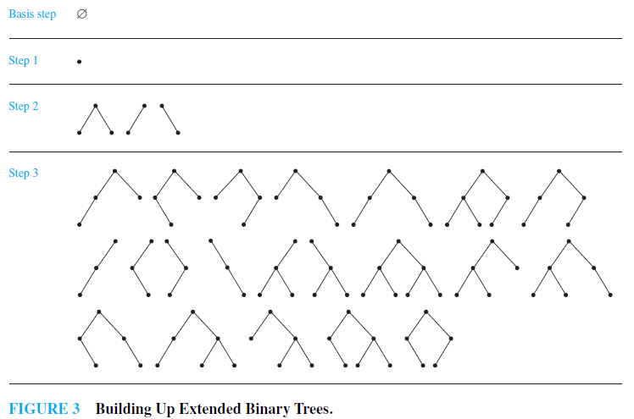
*
School of Computer Science, BUPT

Slide 54
Full Binary Trees
A special case of extended binary trees.
Recursive definition of FBTs:
  A single node r is a full binary tree.
    Note this is different from the EBT base case.
  If T₁,T₂ are disjoint FBTs, there is a full binary tree, denoted by T₁ · T₂ , consisting of a root r together with edges connecting the root to each of the roots of the left subtree T₁ and the right subtree T₂ .
    Note this is the same as the EBT recursive case!
Draw some examples…
*
School of Computer Science, BUPT

Slide 55
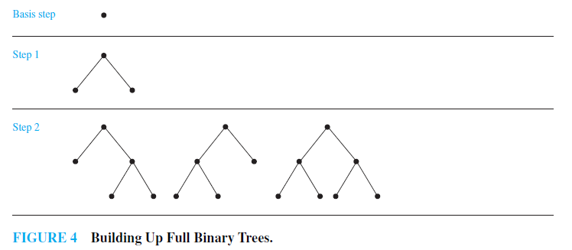
*
School of Computer Science, BUPT

Slide 56
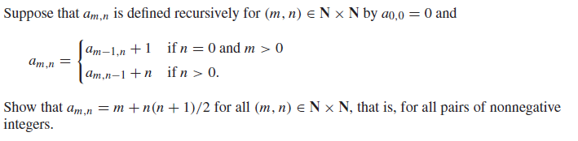
Generalized Induction
Example 13
*
School of Computer Science, BUPT

Slide 57
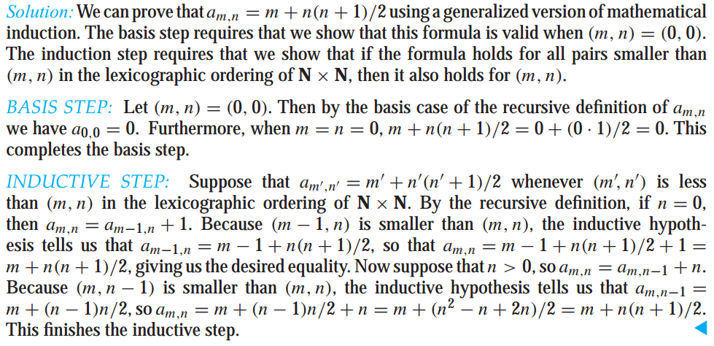
*
School of Computer Science, BUPT

Slide 58
Homework
§5.3
  20, 50
*
School of Computer Science, BUPT

